Slide 1
Exploring Racism in Higher Education
Facilitator: ALBERT YALLEY

Slide 2
Understanding Racism
Racism is the belief in the inherent superiority of one race over all others and thereby the right to dominance ( lords,1995)
Racism is a system of ignorance, exploitation, and power used to oppress African-Americans, Latinos, Asians, Pacific Americans, American Indians and other people because of ethnicity, culture, mannerism and color (Marable,1992 ).

Slide 3
Understanding Racism
One group belief itself to be superior
The group that beliefs itself to be superior has the power to carry out the racist behavior
Racism affects multiple racial and ethnic groups

Slide 4
Understanding Racism
Racism is white racial and cultural prejudice and discrimination, supported intentionally or unintentionally by institutional power and authority, used to the advantage of white and disadvantage of people of color (Sensoy, & DiAngelo,2017).

Slide 5

Why Racism Conversation as Educators
Fosters institutional change by helping to evaluate and reform policies, practices and procedures that perpetuate inequities by engaging in conversations and initiatives that contribute to creating more inclusive and just academic environment
It challenges us to analyze power dynamics, social structures and historical context critically to foster a deeper understanding of how racism operates beyond individual biases, challenging student to question assumptions and engage in nuanced discussion about Privileges, oppression and social justice
Addressing structural racism is crucial for promoting diversity, equity and inclusion in our campuses, acknowledging historical and ongoing disparities and dismantling institutional barriers.
Notes:
Racism is a form of oppression in which one racial group dominates over others. Addressing this pervasive issue in higher education is paramount, as it is essential for fostering equity, diversity, and inclusion. By confronting historical and ongoing disparities and dismantling institutional barriers, institutions can create a more equitable learning environment. Today, our focus will be on recent admissions policy trends in higher education, which directly relate to our ongoing discussion on structural racism. Admissions policies wield significant influence over access to education and can either perpetuate or mitigate systemic inequalities. We'll delve into how these trends intersect with institutional power dynamics and contribute to the perpetuation of structural racism.

Slide 6
Forms of Racism in Schools
Structural racism: Policies, practices and procedures that perpetuate racial inequalities, such as disparities in admissions, funding and faculty hiring e.g. : racial stereotype
Microaggression: They are small comment(verbal, nonverbal or Visual) that are said, done or seen directed toward people of color, often automatically or unconscious (Solórzano, Ceja &Yosso,2000). It create hostile environment for minority student and faculty.
Notes:
Implicit biases, or unconscious biases, affect how fair people are treated. These biases are profoundly ingrained in decision-making, especially in school, where preconceived conceptions can unjustly impair academic performance. Structural racism perpetuates educational inequality by underfunding minority schools. Standardized testing policies exacerbate these discrepancies and disfavor impoverished pupils in school. Microaggressions, minor kinds of discrimination, cloud admissions. Stereotypes about persons of race circulate quickly and make colleges inhospitable to minority candidates.

Slide 7
Continued……
Curriculum Bias: Absence of diverse perspectives and experiences in course materials syllabi, and academic discourse can reinforce dominant narratives and exclude minority voices
Discriminatory Behaviors: overt act such as harassment, exclusion, differential treatment based on race among students, faculty, or staff members within our institutions
Notes:
Despite laws fixing these wrongs, racial and ethnic prejudice in student admissions persists. African Americans made up 13% and Latinos 20% of post-secondary students. This illustrates that Black and Hispanic pupils struggle to get into college (Mora, 2022). This shows how "redlining" from the past still affects educational opportunities now. Still, continued work is needed to remedy these challenges, highlighting the importance of making schools more inclusive.

Slide 8
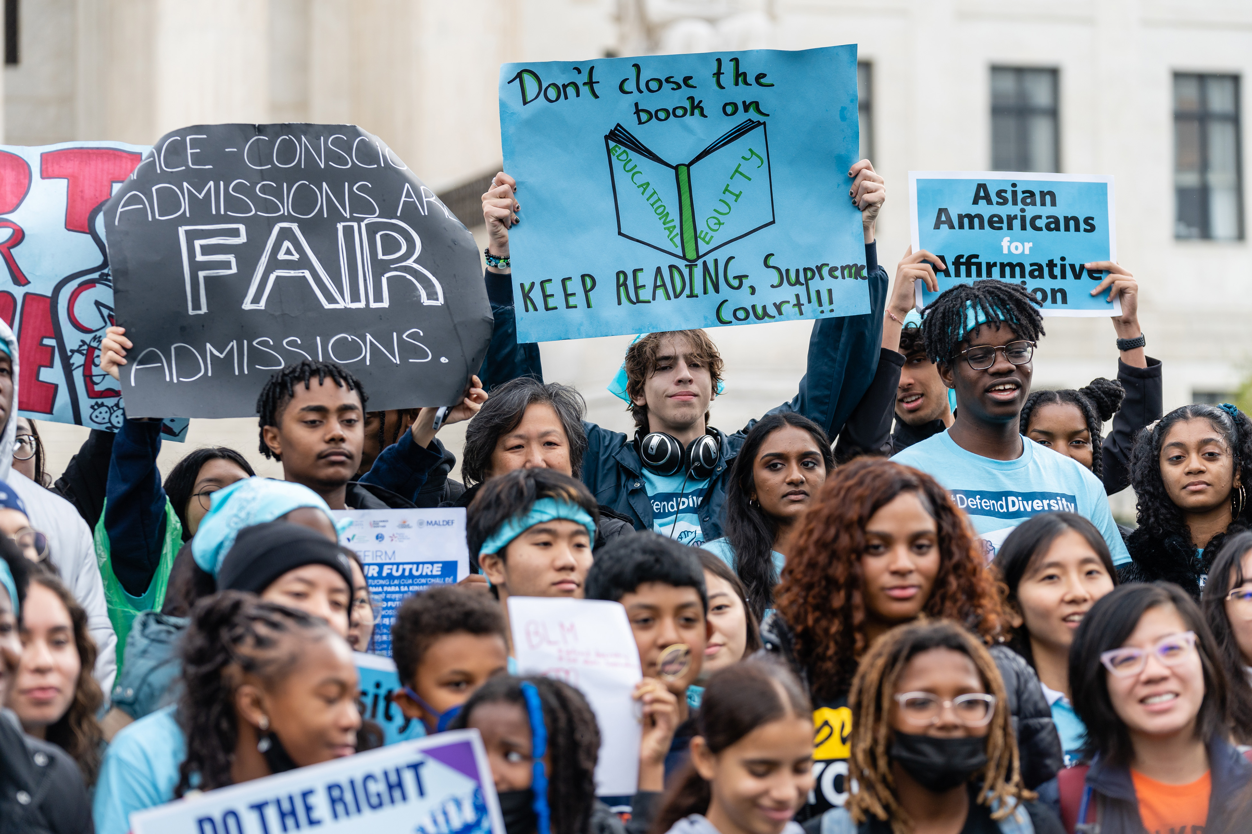
Methods to Mitigate Racism in School
Mandatory programs for admission officers to recognize and mitigate biases.
Implement comprehensive diversity and inclusion initiatives that prioritize representation.
Carry out regular review and revise policies and practices to address biases
Acknowledge and value diverse experiences and achievements.
Recognize and address intersecting identities and experiences of people of color
Provide anti-racism and cultural competence education and training for faculty and staff
Create and support affinity groups and safe spaces for the marginalized group.
Notes:
Creating programs for admissions agents involves implicit bias training. These projects aim to raise awareness of biases and help decision-makers reduce them. The admissions procedure aims to aid fair decision-making. Applying for admissions broadly involves considering more than test scores and grades. Knowing that academic success isn't only about numbers, the aforementioned strategy emphasizes candidates' diverse experiences and accomplishments. Simple policies make things fairer. Clearly sharing the regulations helps make the admissions process transparent, revealing the criteria and decision-making process. Clear communication creates trust and eases concerns about admissions fairness. Equality requires community involvement. Include the community in the admissions process to consider multiple perspectives and promote communication between local groups and schools. Participation like this makes admissions more fair and inclusive. Continuous Monitoring emphasizes the need to regularly review the application process. The admissions process must be continuously improved and monitored to identify and address any remaining prejudices.

Slide 9
Moving Forward
Key Insights
Addressing structural racism in admissions is vital for equitable education and dismantling systemic inequalities.
Continued Exploration
Let's commit to ongoing discussions and actions to create inclusive higher education environments.
Thank You:
Thank you for your thoughtful participation and engagement in today's dialogue.
Closing Remarks:
Together, we can work towards a more just and equitable higher education system.
Notes:
Moving forward, it's crucial to recognize the significance of tackling structural racism within admissions processes to ensure equitable education opportunities and break down systemic inequalities. Let's remain dedicated to fostering ongoing dialogues and implementing actions that promote inclusivity and diversity within higher education environments. Your thoughtful participation and engagement in today's discussion are greatly appreciated. Together, let's strive towards building a more just and equitable higher education system that empowers all individuals to thrive and succeed.

Slide 10
References
Sensoy, O., & DiAngelo, R. (2017). Is Everyone Really Equal?: An Introduction to Key Concepts in Social Justice Education, Second Edition. In Google Books. Teachers College Press. https://books.google.co.ke/books/about/Is_Everyone_Really_Equal.html?id=t4stDwAAQBAJ&redir_esc=y
Mora, L. (2022, October 7). Hispanic enrollment reaches new high at four-year colleges in the U.S., but affordability remains an obstacle. Pew Research Center. https://www.pewresearch.org/short-reads/2022/10/07/hispanic-enrollment-reaches-new-high-at-four-year-colleges-in-the-u-s-but-affordability-remains-an-obstacle/
Solorzano, D., Ceja, M., & Yosso, T. (2000). Critical race theory, racial microaggressions, and campus racial climate: The experiences of African American college students. Journal of Negro education, 60-73.

